Slide 1
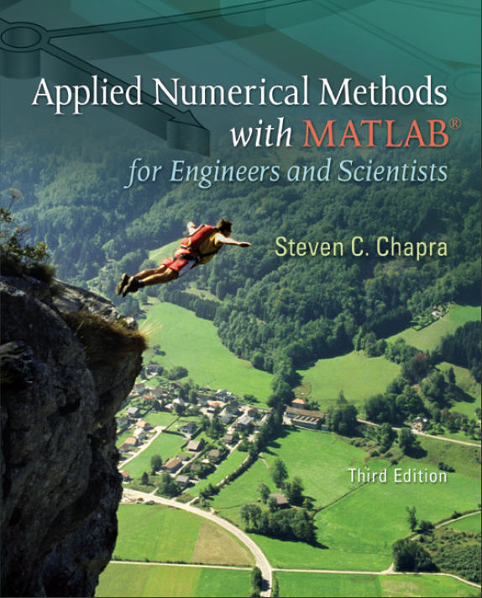
Part 4
Chapter 17
Polynomial Interpolation
PowerPoints organized by Dr. Michael R. Gustafson II, Duke University
All images copyright © The McGraw-Hill Companies, Inc. Permission required for reproduction or display.

Slide 2
Chapter Objectives
Recognizing that evaluating polynomial coefficients with simultaneous equations is an ill-conditioned problem.
Knowing how to evaluate polynomial coefficients and interpolate with MATLAB’s polyfit and polyval functions.
Knowing how to perform an interpolation with Newton’s polynomial.
Knowing how to perform an interpolation with a Lagrange polynomial.
Knowing how to solve an inverse interpolation problem by recasting it as a roots problem.
Appreciating the dangers of extrapolation.
Recognizing that higher-order polynomials can manifest large oscillations.

Slide 3
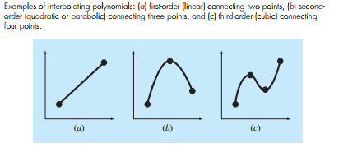

Slide 4
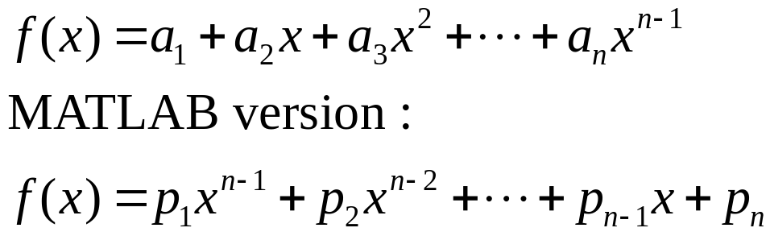
Polynomial Interpolation
You will frequently have occasions to estimate intermediate values between precise data points.
The function you use to interpolate must pass through the actual data points - this makes interpolation more restrictive than fitting.
The most common method for this purpose is polynomial interpolation, where an (n-1)^{th} order polynomial is solved that passes through n data points:

Slide 5
Determining Coefficients
Since polynomial interpolation provides as many basis functions as there are data points (n), the polynomial coefficients can be found exactly using linear algebra.
MATLAB’s built in polyfit and polyval commands can also be used - all that is required is making sure the order of the fit for n data points is n-1.

Slide 6
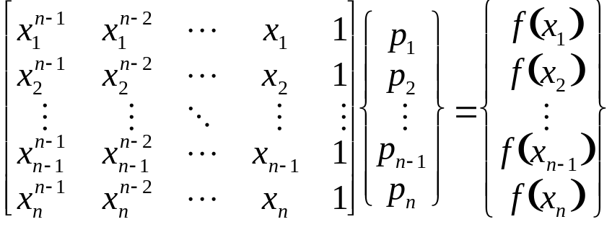
Polynomial Interpolation Problems
One problem that can occur with solving for the coefficients of a polynomial is that the system to be inverted is in the form:
Matrices such as that on the left are known as Vandermonde matrices, and they are very ill-conditioned - meaning their solutions are very sensitive to round-off errors.
The issue can be minimized by scaling and shifting the data.

Slide 7
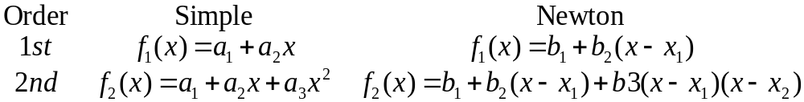
Newton Interpolating Polynomials
Another way to express a polynomial interpolation is to use Newton’s interpolating polynomial.
The differences between a simple polynomial and Newton’s interpolating polynomial for first and second order interpolations are:

Slide 8
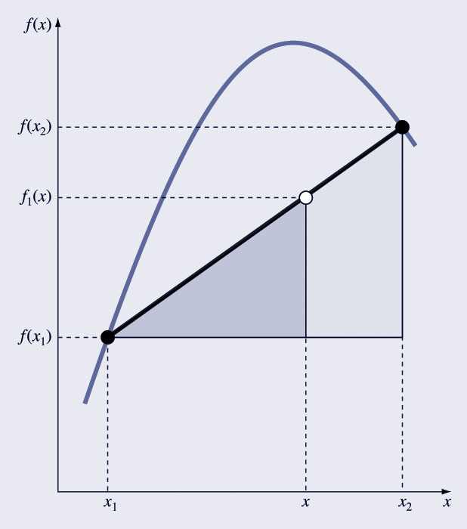
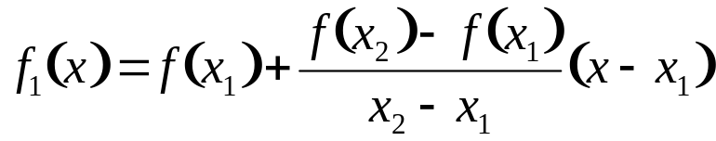
Newton Interpolating Polynomials (cont)
The first-order Newton interpolating polynomial may be obtained from linear interpolation and similar triangles, as shown.
The resulting formula based on known points x₁ and x₂ and the values of the dependent function at those points is:

Slide 9
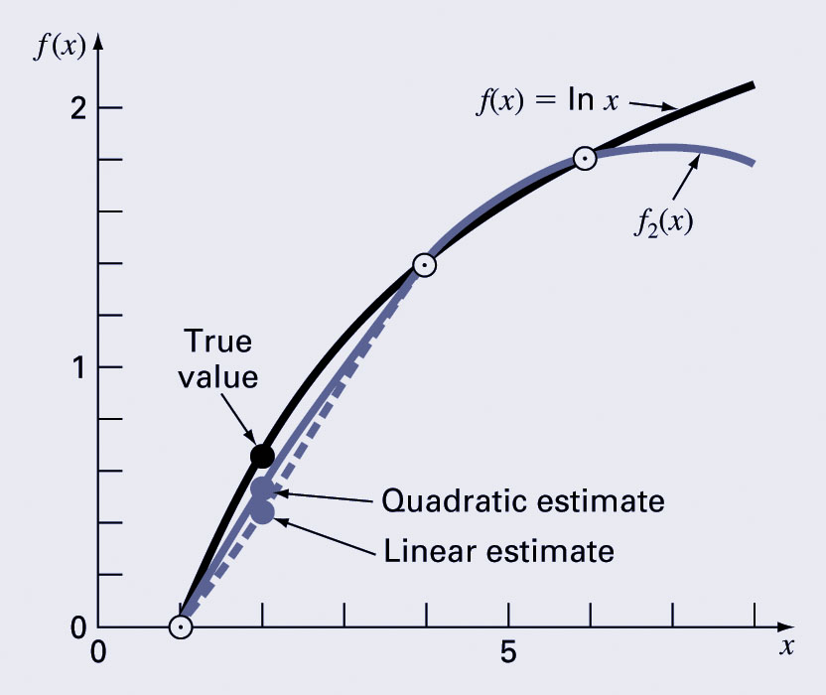
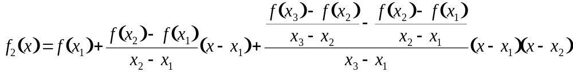
Newton Interpolating Polynomials (cont)
The second-order Newton interpolating polynomial introduces some curvature to the line connecting the points, but still goes through the first two points.
The resulting formula based on known points x₁, x₂, and x₃ and the values of the dependent function at those points is:

Slide 10
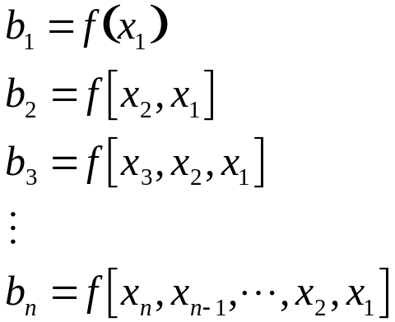
Newton Interpolating Polynomials (cont)
The general formula is:
where
and the f[…] represent divided differences.

Slide 11
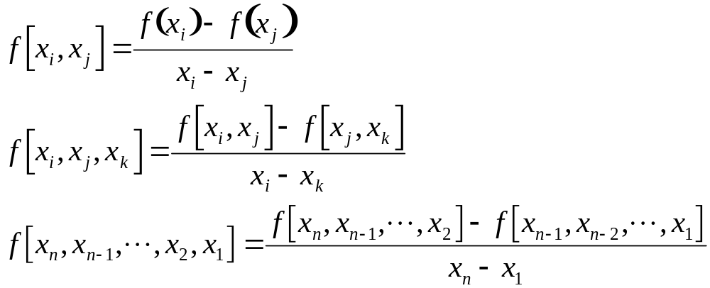
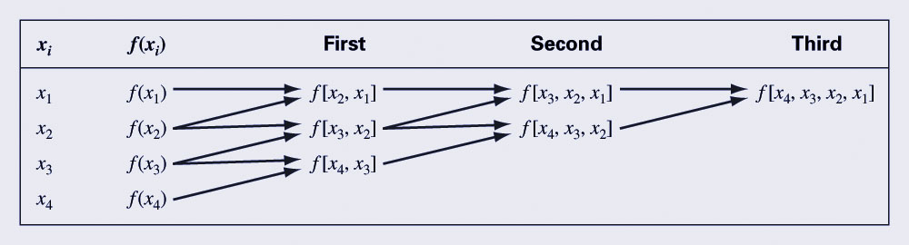
Divided Differences
Divided difference are calculated as follows:
Divided differences are calculated using divided difference of a smaller number of terms:

Slide 12
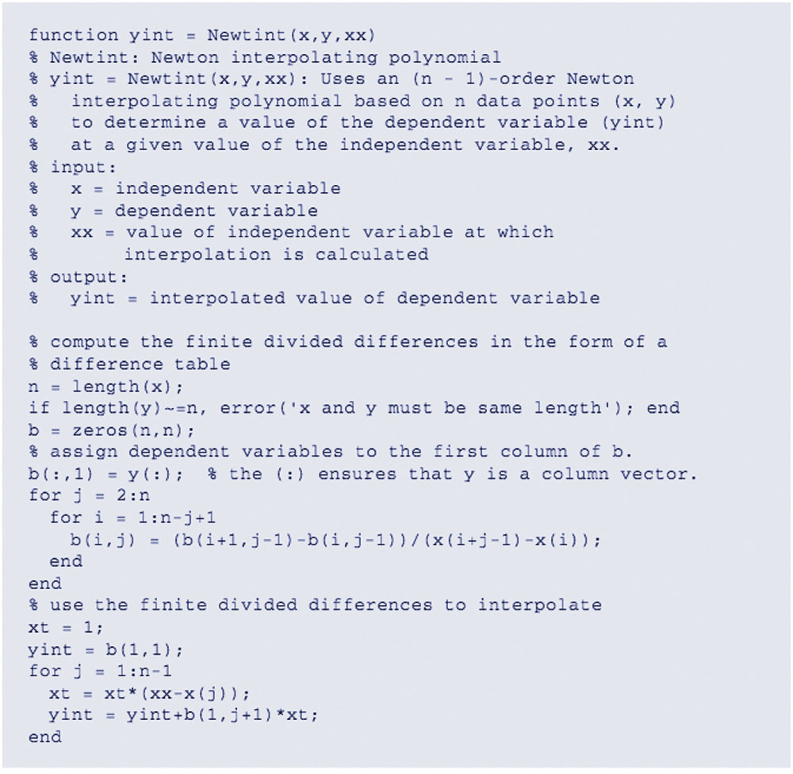
MATLAB Implementation

Slide 13
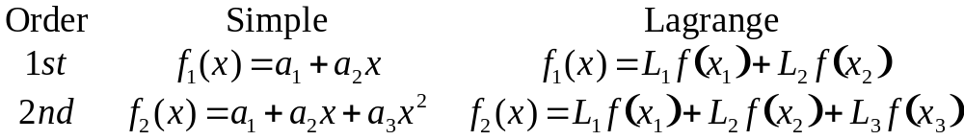
Lagrange Interpolating Polynomials
Another method that uses shifted value to express an interpolating polynomial is the Lagrange interpolating polynomial.
The differences between a simply polynomial and Lagrange interpolating polynomials for first and second order polynomials is:
where the L_{i} are weighting coefficients that are functions of x.

Slide 14
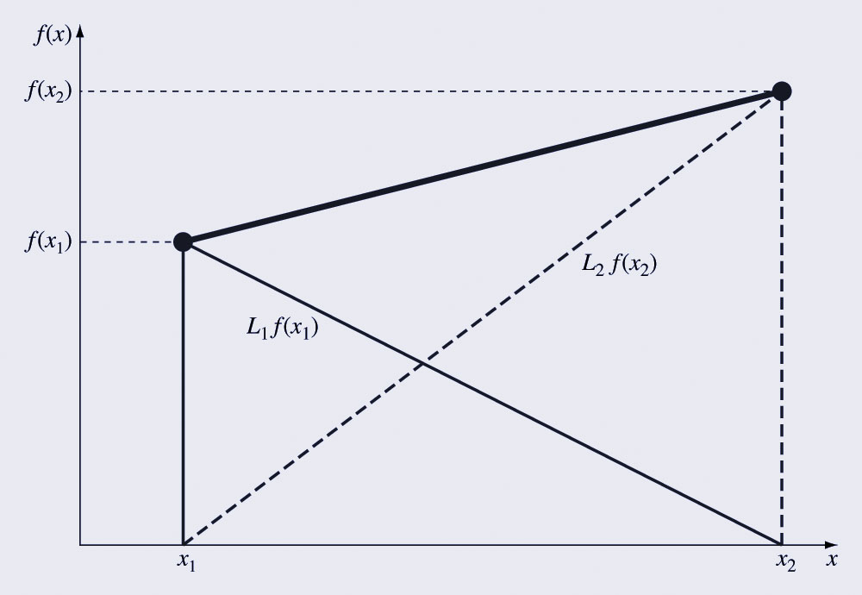
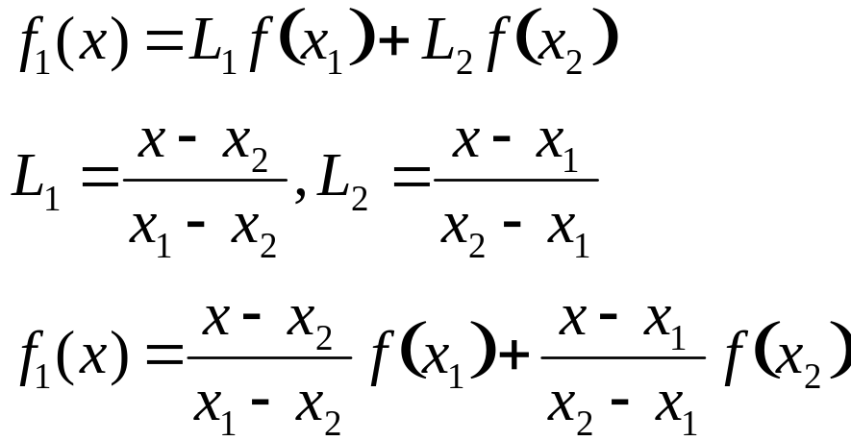

Lagrange Interpolating Polynomials (cont)
The first-order Lagrange interpolating polynomial may be obtained from a weighted combination of two linear interpolations, as shown.
The resulting formula based on known points x₁ and x₂ and the values of the dependent function at those points is:

Slide 15
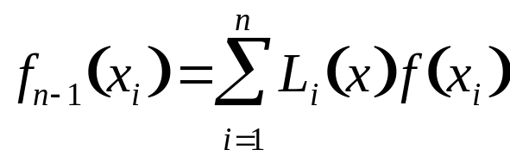
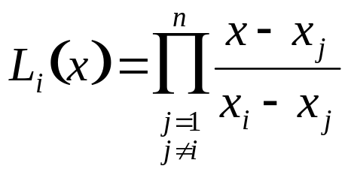
Lagrange Interpolating Polynomials (cont)
In general, the Lagrange polynomial interpolation for n points is:
where L_{i} is given by:

Slide 16
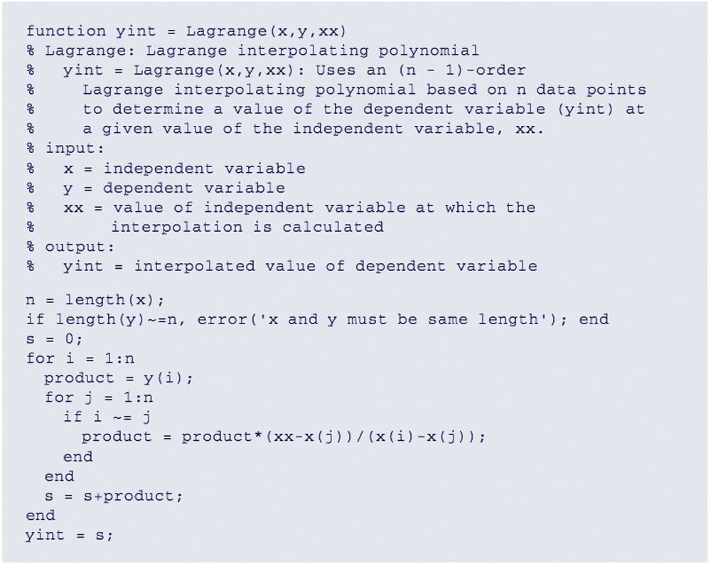
MATLAB Implementation

Slide 17
Inverse Interpolation
Interpolation general means finding some value f(x) for some x that is between given independent data points.
Sometimes, it will be useful to find the x for which f(x) is a certain value - this is inverse interpolation.
Rather than finding an interpolation of x as a function of f(x), it may be useful to find an equation for f(x) as a function of x using interpolation and then solve the corresponding roots problem:
f(x)-f_{desired}=0 for x.

Slide 18
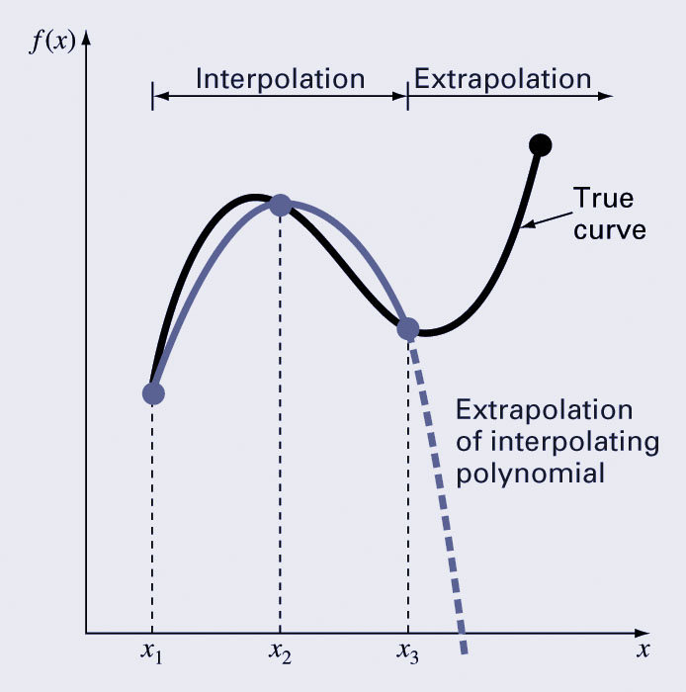
Extrapolation
Extrapolation is the process of estimating a value of f(x) that lies outside the range of the known base points x₁, x₂, …, x_{n}.
Extrapolation represents a step into the unknown, and extreme care should be exercised when extrapolating!

Slide 19
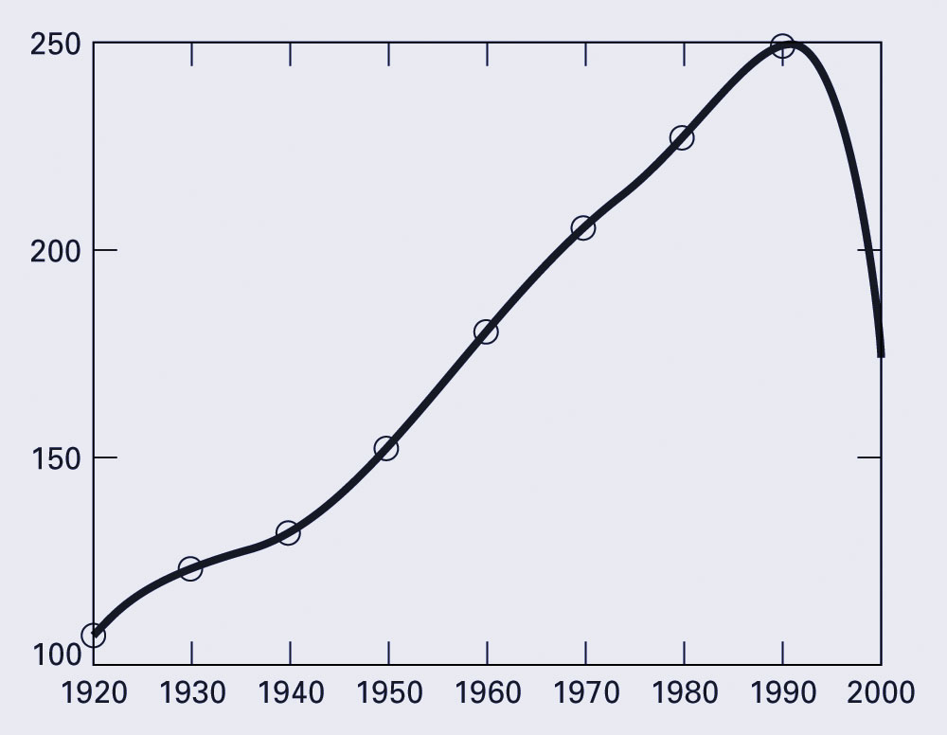
Extrapolation Hazards
The following shows the results of extrapolating a seventh-order population data set:

Slide 20
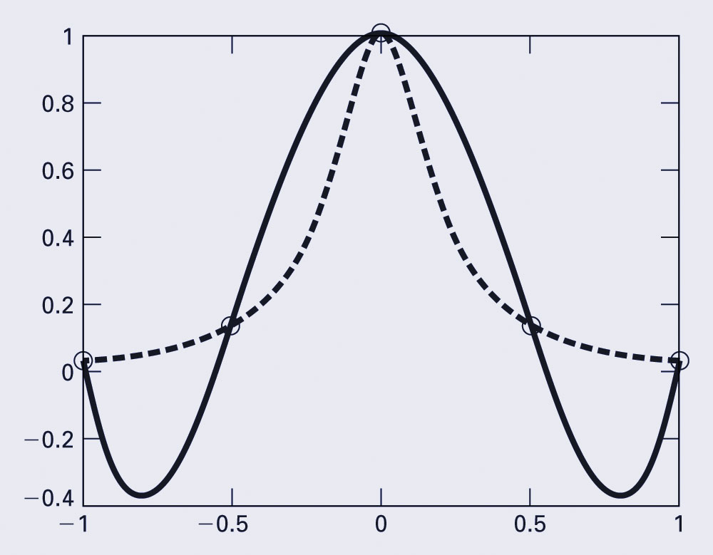
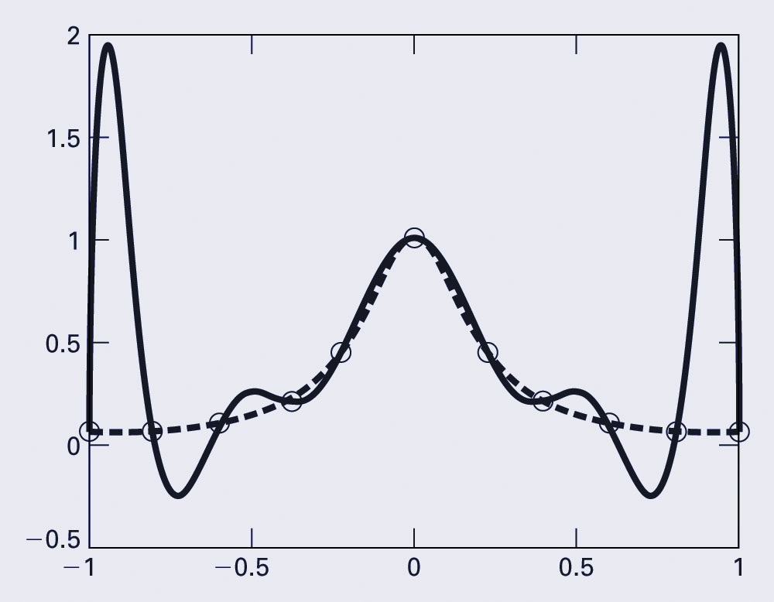
Oscillations
Higher-order polynomials can not only lead to round-off errors due to ill-conditioning, but can also introduce oscillations to an interpolation or fit where they should not be.
In the figures below, the dashed line represents an function, the circles represent samples of the function, and the solid line represents the results of a polynomial interpolation:

